Slide 1
CSE 576 Slide Set 2:
Probability and its use in NLP
Adapted from Prof. Ray Mooney’s NLP class slides

Slide 2
Probability in NLP – countering ambiguity; probability of a seeing a word
Ambiguity means multiple possibilities
  Countering ambiguity
    Use knowledge to reduce the number of possibilities to 1.
    Use knowledge to assign probabilities to the various possibilities and use the one with the highest probability.
The probability of encountering a string – how probable is a particular sequence of words.

Slide 3
CFG and PCFG
Formal grammars (e.g. regular, context free) give a hard “binary” model of the legal sentences in a language. (CFG)
For NLP, a probabilistic model of a language that gives a probability that a string is a member of a language is more useful. (PCFG)
Notes:
http://www.cs.columbia.edu/~mcollins/courses/nlp2011/notes/pcfgs.pdf

Slide 4
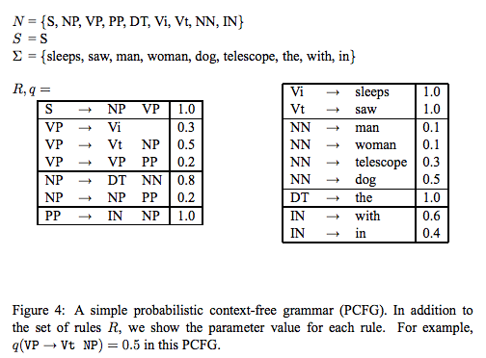
A PCFG examples
Notes:
http://www.cs.columbia.edu/~mcollins/courses/nlp2011/notes/pcfgs.pdf
N – Non Terminals
Sigma – Terminals
S – Start symbol
R – Rules; q – probability of rules

Slide 5
Other use of probability
Speech recognition
  “I ate a cherry” is a more likely sentence than “Eye eight uh Jerry”
OCR & Handwriting recognition
  More probable sentences are more likely correct readings.
Machine translation
  More likely sentences are probably better translations.
Generation
  More likely sentences are probably better NL generations.
Context sensitive spelling correction
  “Their are problems wit this sentence.”
  Probability of a particular word in a string given information about the other words

Slide 6
Completion Prediction
A probabilistic language model also supports predicting the completion of a sentence.
  Please turn off your cell _____
  Your program does not ______
Predictive text input systems can guess what you are typing and give choices on how to complete it.

Slide 7
N-Gram Models
Estimate probability of each word given prior context.
  P(phone | Please turn off your cell)
Number of parameters required grows exponentially with the number of words of prior context.
An N-gram model uses only N−1 words of prior context.
  Unigram: P(phone)
  Bigram: P(phone | cell)
  Trigram: P(phone | your cell)
The Markov assumption is the presumption that the future behavior of a dynamical system only depends on its recent history. In particular, in a kth-order Markov model, the next state only depends on the k most recent states, therefore an N-gram model is a (N−1)-order Markov model.

Slide 8
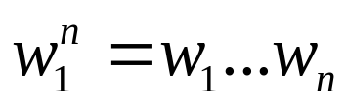
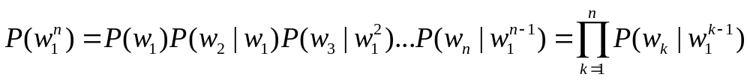
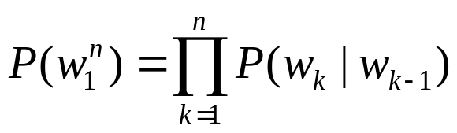
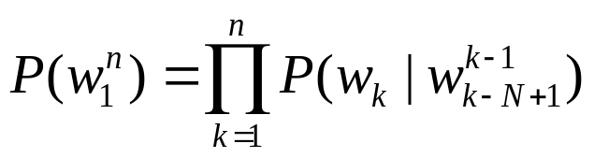
N-Gram Model Formulas
Word sequences
Chain rule of probability for word sequences
Bigram approximation
N-gram approximation

Slide 9
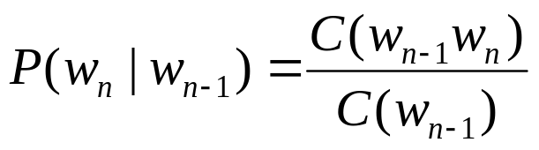
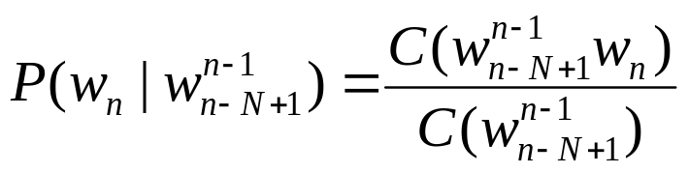
Estimating Probabilities
N-gram conditional probabilities can be estimated from raw text based on the relative frequency of word sequences.
Initialization: Append a unique start (<s>) and end (</s>) symbol to every sentence and treat these as additional words.
Bigram:
N-gram:
Notes:
To have a consistent probabilistic model, append a unique start (<s>) and end (</s>) symbol to every sentence and treat these as additional words.

Slide 10
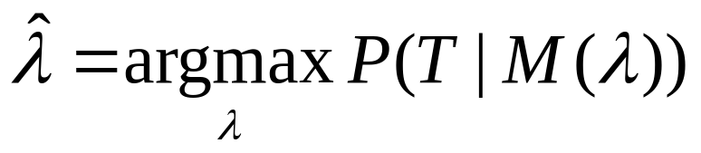
Generative Model & MLE
An N-gram model can be seen as a probabilistic automata for generating sentences.
Relative frequency estimates can be proven to be maximum likelihood estimates (MLE) since they maximize the probability that the model M will generate the training corpus T.
Initialize sentence with N−1 <s> symbols
Until </s> is generated do:
Stochastically pick the next word based on the conditional
probability of each word given the previous N −1 words.

Slide 11
Example from a book
P(<s> i want english food </s>)
= P(i | <s>) P(want | i) P(english | want)
P(food | english) P(</s> | food)
= .25 x .33 x .0011 x .5 x .68 = .000031
P(<s> i want chinese food </s>)
= P(i | <s>) P(want | i) P(chinese | want)
P(food | chinese) P(</s> | food)
= .25 x .33 x .0065 x .52 x .68 = .00019

Slide 12
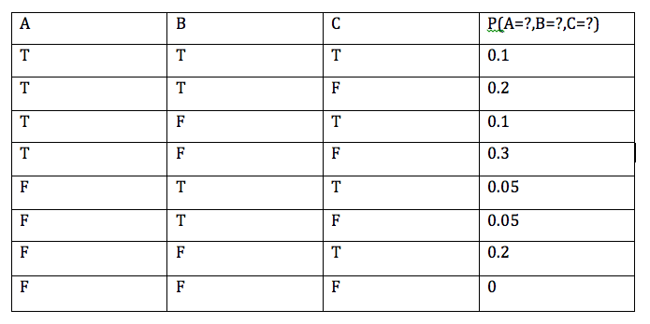
A Detour on Probability
Basic probability definitions; Use of MLE (Maximum Likelihood Estimation) to determine p(head); Conditional Probabilities, Joint Probability Distribution)

Slide 13
Basic probability formulas
P(A) = P(A,B) + P(A,~B)
= P(A,B,C) + P(A,B,~C) + P(A,~B,C) + P(A, ~B,~C).
P(A) + P(~A) = 1
P(A,B) = P(A) X P(B|A) = P(B) X P(A|B)
P(B|A) = P(A,B) / P(A) = ( P(B) X P(A|B) ) / P(A)
P(A,B|__) = P(A|__) X P(B|A,__) = P(B|__) X P(A|B,__)

Slide 14
MLE parameter estimation – from counts to probability
If we toss a coin and it comes out n heads and m tails then how fair is the coin. I.e., what is the probability (θ) of the coin toss resulting in a head.
MLE: is that value which maximizes what we have seen in the data.
θ = argmax P(a seq. with n heads and m tails | θ)
θ
P(a seq. with n heads and m tails | θ) = ??
Lets call it f(θ).

Slide 15
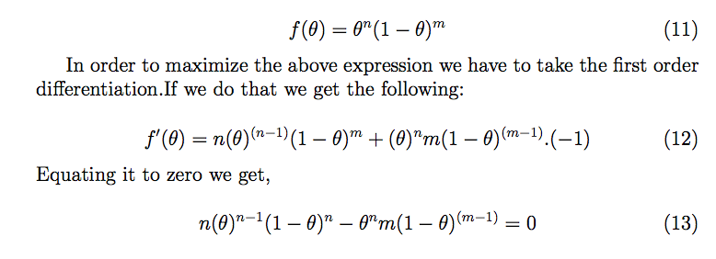
Maximum Likelihood Estimation

Slide 16
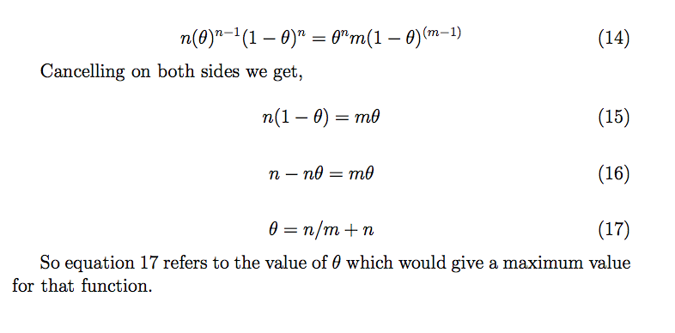
Maximum Likelihood Estimation – cont.
Notes:
Three solutions: theta = 0, theta = 1, theta = n/(m+n).
f(0) = f(1) = 0. MINIMA
f(n/m+n) > 0. MAXIMA

Slide 17
Train and Test Corpora
A language model must be trained on a large corpus of text to estimate good parameter values.
Model can be evaluated based on its ability to predict a high probability for a disjoint (held-out) test corpus (testing on the training corpus would give an optimistically biased estimate).
Ideally, the training (and test) corpus should be representative of the actual application data.

Slide 18
Unknown Words
How to handle words in the test corpus that did not occur in the training data, i.e. out of vocabulary (OOV) words?
Train a model that includes an explicit symbol for an unknown word (<UNK>).
  Alternative 1: Choose a vocabulary in advance and replace other words in the training corpus with <UNK>.
  Alternative 2: Replace the first occurrence of each word in the training data with <UNK>.

Slide 19
Evaluation of Language Models
Ideally, evaluate use of model in end application (extrinsic, in vivo)
  Realistic
  Expensive
Evaluate on ability to model test corpus (intrinsic).
  Less realistic
  Cheaper
Verify at least once that intrinsic evaluation correlates with an extrinsic one.

Slide 20
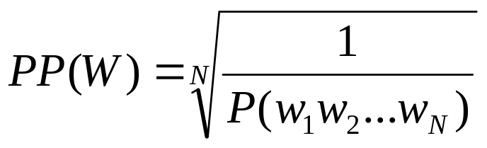
An intrinsic evaluation metric: Perplexity
Measure of how well a model “fits” the test data.
Uses the probability that the model assigns to the test corpus.
Normalizes for the number of words in the test corpus and takes the inverse.
Low perplexity is better
  High value of P(w₁ w₂ w_{N}) is better.
  Longer sentence will have lower probability, so need to normalize that.
Notes:
perplexity is a measurement of how well a probability distribution or probability model predicts a sample. w1 is a word. w1 … wN is a sentence of N words. High probability is good. Perplixity is inverse of that. Now longer senetence will have lower probability, so better to normalize it.

Slide 21
Sample Perplexity Evaluation
Models trained on 38 million words from the Wall Street Journal (WSJ) using a 19,979 word vocabulary.
Evaluated on a disjoint set of 1.5 million WSJ words.
 | Unigram | Bigram | Trigram
Perplexity | 962 | 170 | 109

Slide 22
Smoothing
Since there are a combinatorial number of possible word sequences, many rare (but not impossible) combinations never occur in training, so MLE incorrectly assigns zero to many parameters (a.k.a. sparse data).
If a new combination occurs during testing, it is given a probability of zero and the entire sequence gets a probability of zero (i.e. infinite perplexity).
In practice, parameters are smoothed (a.k.a. regularized) to reassign some probability mass to unseen events.
  Adding probability mass to unseen events requires removing it from seen ones (discounting) in order to maintain a joint distribution that sums to 1.

Slide 23
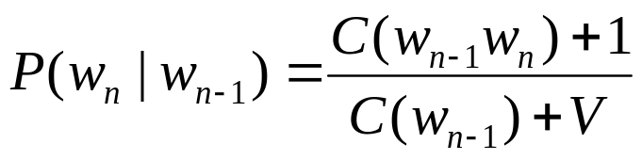
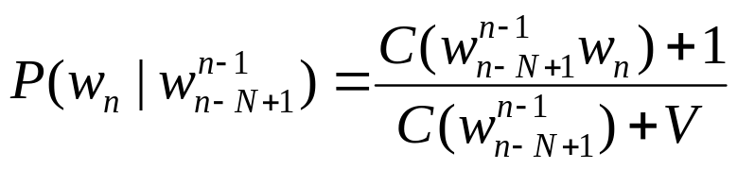
Laplace (Add-One) Smoothing
“Hallucinate” additional training data in which each possible N-gram occurs exactly once and adjust estimates accordingly.
where V is the total number of possible (N−1)-grams (i.e. the vocabulary size for a bigram model).
Bigram:
N-gram:
Tends to reassign too much mass to unseen events, so can be adjusted using 0<δ<1 (normalized by δV instead of V).

Slide 24
Advanced Smoothing
Many advanced techniques have been developed to improve smoothing for language models.
  Good-Turing
  Interpolation
  Backoff
  Kneser-Ney
  Class-based (cluster) N-grams

Slide 25
Model Combination
As N increases, the power (expressiveness) of an N-gram model increases, but the ability to estimate accurate parameters from sparse data decreases (i.e. the smoothing problem gets worse).
A general approach is to combine the results of multiple N-gram models of increasing complexity (i.e. increasing N).

Slide 26
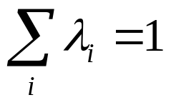
Interpolation
Linearly combine estimates of N-gram models of increasing order.
Interpolated Trigram Model:
Where:
Learn proper values for λ_{i} by training to (approximately) maximize the likelihood of an independent development (a.k.a. tuning) corpus.

Slide 27
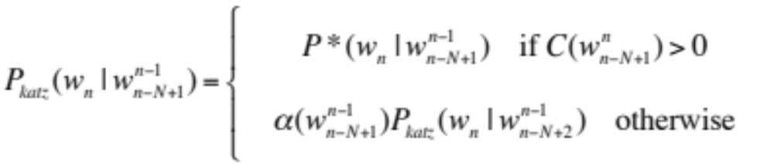
Backoff
Only use lower-order model when data for higher-order model is unavailable (i.e. count is zero).
Recursively back-off to weaker models until data is available.
Where P* is a discounted probability estimate to reserve mass for unseen events and α’s are back-off weights (see Jurafsky & Martin book, page 105 for details).

Slide 28
A Problem for N-Grams:
Long Distance Dependencies
Many times local context does not provide the most useful predictive clues, which instead are provided by long-distance dependencies.
  Syntactic dependencies
    “The man next to the large oak tree near the grocery store on the corner is tall.”
    “The men next to the large oak tree near the grocery store on the corner are tall.”
  Semantic dependencies
    “The bird next to the large oak tree near the grocery store on the corner flies rapidly.”
    “The man next to the large oak tree near the grocery store on the corner talks rapidly.”
More complex models of language are needed to handle such dependencies.

Slide 29
Ngram Viewer; Other LM resources
https://books.google.com/ngrams/info
https://books.google.com/ngrams/
http://googleresearch.blogspot.com/2012/10/ngram-viewer-20.html
Other Language Modeling Resources.
  SRI Language Modeling Kit: http://www.speech.sri.com/projects/srilm/
  CMU toolkit: http://www.speech.cs.cmu.edu/SLM/toolkit.html

Slide 30
Summary
Language models assign a probability that a sentence is a legal string in a language.
They are useful as a component of many NLP systems, such as ASR (automatic speech recognition), OCR (optical character recognition), and MT (machine translation).
Simple N-gram models are easy to train on unsupervised corpora and can provide useful estimates of sentence likelihood.
MLE gives inaccurate parameters for models trained on sparse data.
Smoothing techniques adjust parameter estimates to account for unseen (but not impossible) events.
Notes:
ASR – Automatic Speech Recognition
OCR – Optical Character recognition
MT – Machine Translation

